Slide 1

ENHANCING DOCUMENT VERIFICATION WITH AI
Challenge:​​
This project tackles the challenge of verifying documents, especially in distinguishing authentic documents from forged ones. The difficulty arises from variations in document format and content, along with the high accuracy needed for :
Automating document verification to streamline processes across various fields.​
Accelerating document processing to save time on manual verification.​
Enabling check verification systems by automating account and receiver details processing.​
Verifying the authenticity of legal documents.​
Simplifying and automating registration processes across industries.
Key Solution Highlights:
Data Security and Privacy Compliance
Batch and Real-Time Processing
AI-based extraction for high accuracy
Machine learning-enabled signature matching for verification
Ensure authenticity of document details
Scalable API Integration
Integration with Hyperscalers
Tailor workflows for various industries
USE CASE
Team Name: Pragyanam
Team Members: Absaar Ali, Isha Thakur, Jagrit Digga, Mohd Saif, Prashant Tiwari

Slide 2
USE CASES
Banking and Financial Services
Cheque Authentication
Loan Document Verification
Government Services
Handwritten Docs Digitization & Verification
ID Proof Digitization and Verification
Legal Services
Contract Signature Verification
Dispute Resolution

Slide 3
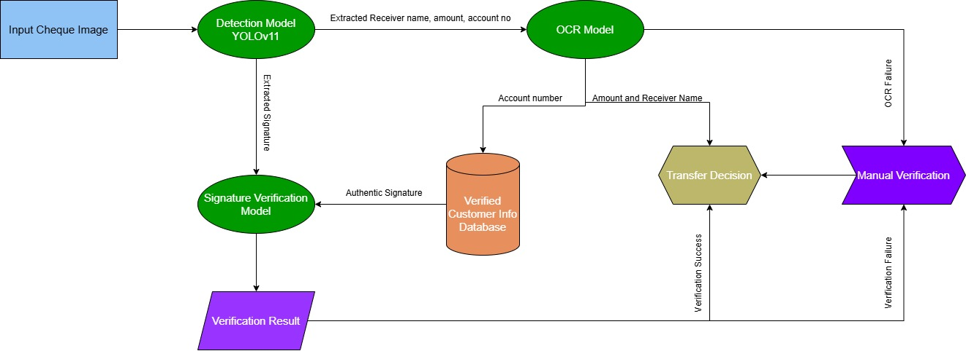
Specific Use Case for Cheque Verification
Flowchart for Cheque verification system

Slide 4
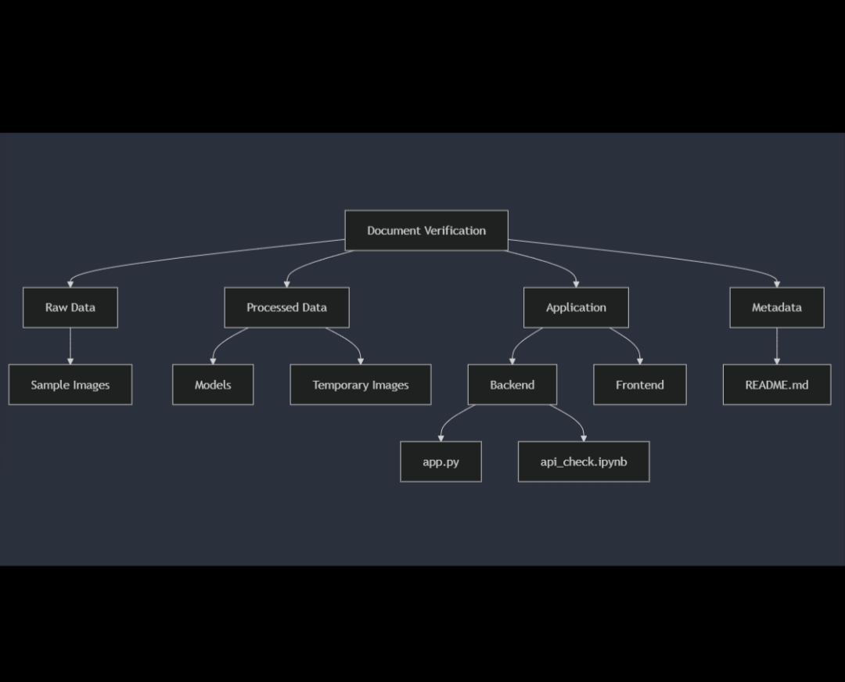
Cloud Architecture for Document Verification
Key Components
Data Flow
Frontend (Streamlit) → AWS Elastic Beanstalk, Azure Web App, or Google App Engine.
Frontend (Streamlit) → AWS Elastic Beanstalk, Azure Web App, or Google App Engine.
Frontend → Backend (Document Upload)
Frontend → Backend (Document Upload)
Backend → YOLO (Component Detection)
Backend → YOLO (Component Detection)
Backend (FastAPI) → Dockerized and hosted on Kubernetes, AWS Lambda (serverless), or cloud VMs.
Backend (FastAPI) → Dockerized and hosted on Kubernetes, AWS Lambda (serverless), or cloud VMs.
Cropped Data → Models (Extraction and Verification)
Cropped Data → Models (Extraction and Verification)
Backend ↔ Database (Data Retrieval for Verifications)
Backend ↔ Database (Data Retrieval for Verifications)
Models (AI Services) → GPU-enabled cloud instances (AWS EC2, GCP Compute Engine, or Azure ML).
Models (AI Services) → GPU-enabled cloud instances (AWS EC2, GCP Compute Engine, or Azure ML).
Backend → Frontend (Results)
Backend → Frontend (Results)
Temporary Storage → Cloud storage (AWS S3, GCP Cloud Storage, Azure Blob).
Temporary Storage → Cloud storage (AWS S3, GCP Cloud Storage, Azure Blob).
Database → Managed SQL Database (AWS RDS, Google Cloud SQL, Azure SQL).
Database → Managed SQL Database (AWS RDS, Google Cloud SQL, Azure SQL).
Monitoring & Logging → CloudWatch (AWS), Stackdriver (GCP), or Azure Monitor.
Integrate real time alerts for anomalies ex. failed doc. upload.
Scalability
Horizontal Scaling: Kubernetes Horizontal Pod AutoScaler(HPA) or AWS EC2 Auto scaling to handle high traffic during peak loads.
Cost Optimization: Use serverless for infrequent tasks; reserve instances for heavy AI workloads.
Fault Tolerance: Cloud-managed services with multi-region support ensure reliability.

Slide 5
ADVANTAGES
Scalable and Adaptable: Can be integrated into different platforms with customization based on specific requirements (e.g., banking, healthcare).
Speed and Efficiency: Speeds up document verification processes compared to manual reviews, improving turnaround times.
Pre-trained Models: Likely uses pre-trained models, reducing the need for extensive training data and computational costs.
LIMITATIONS
Variations in handwriting styles and cheque layouts can cause OCR errors, leading to incorrect data extraction.
High computational demands of OCR model can slow down the process for images where it has to be done multiple times.
ShuffleNet might yield less accurate signature verification, increasing the risk of false acceptances or rejections as it is a model for edge devices, for better accuracy we need to use a bigger model trained on more data.

